Slide 1
Today’s Lecture:
Energy Generation in Stars
• Nuclear Reactions
• Fusion of Hydrogen
• Lifetime of Sun
• Solar Neutrinos
Homework 4: Due in class, Tuesday, March 4
Moodle: lectures, homework, homework solutions and grades
Reading for Today’s Lecture: Chapter 9.1 -9.3
Reading for Next Lecture: Chapter 9.4 - 9.6

Slide 2
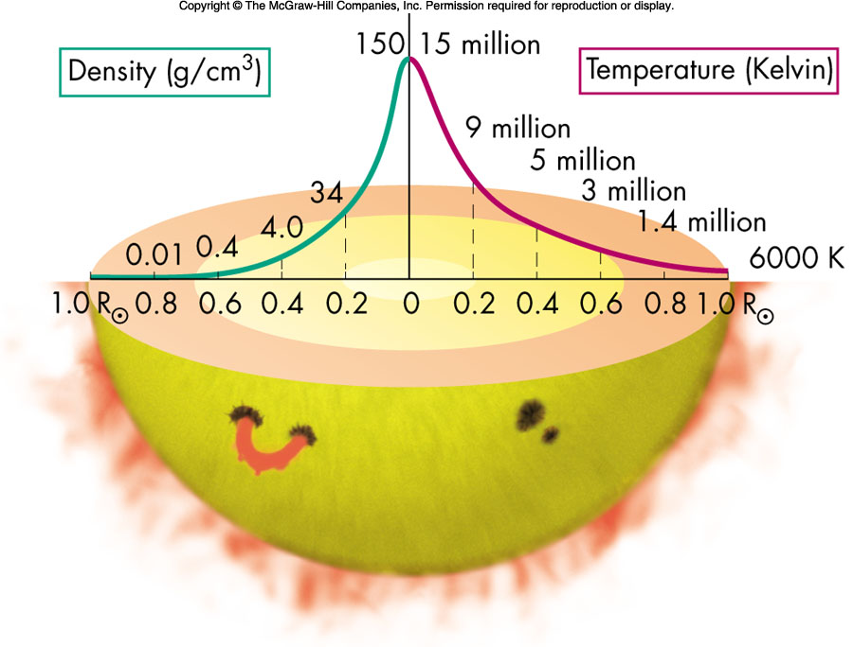
Internal Structure of the Sun
The center of the Sun has a very high temperature (and density) – as we will see next lecture this is needed for the Sun to maintain a stable equilibrium.
Central temperature of the Sun is of order 15 million degrees (1.5x10⁷ K), and central density is more than 30 times denser than the Earth. Temperature and density decrease to surface.

Slide 3
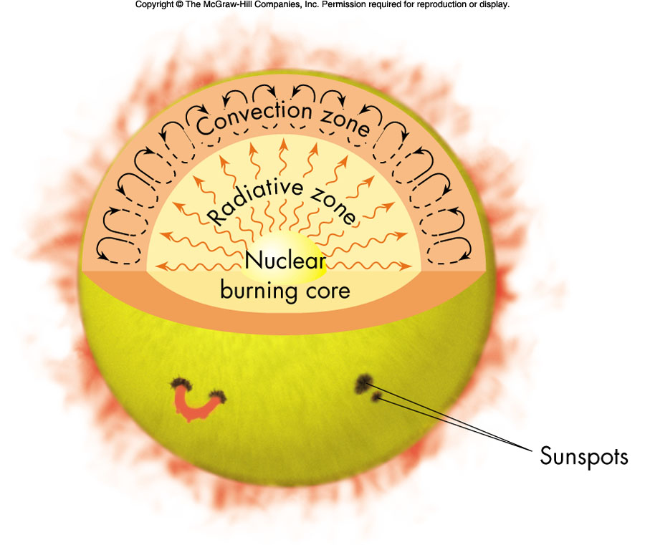
Sun’s Energy Loss
Heat flows from high temperature regions to low temperature regions. Radiation and convection transports energy to surface, where it is finally radiated away. Time required - about 100,000 years.
The rate of energy loss is the Sun’s luminous energy output. Sun’s luminosity is L⊙ = 3.8x10³³ ergs s⁻¹ or 3.8x10²⁶ watts.

Slide 4
Sun’s Energy Production
To maintain an equilibrium, the Sun must replace the ~4x10³³ ergs of energy lost each second, and it has to do this for at least 4.7 billion years (the age of the Sun). How ?
Chemical Reactions: Early 1800’s, thought it could be chemical energy – such as burning of coal. Chemical reactions only liberate a few eV of energy, even if the Sun was entirely made up of high grade coal it would only last thousands of years (homework question addresses the lifetime).
Gravitational Potential Energy: Late 1800’s, it was suggested that the Sun was slowly collapsing releasing gravitational potential energy. This could provide the Sun luminosity for a longer period of time.

Slide 5
Gravitational Potential energy:
Gravitational potential energy of a uniform density sphere of mass, M, and radius, R, is given by:
U = -3/5 GM²/R
We can compute the change in U with change in R by taking the derivative: dU/dR = 3/5 GM²/R²
Thus the change in gravitational potential energy, dU, for a change in R, dR, is: dU = 3/5 GM²/R² dR
If the Sun contracts by 10% (dR = 0.1 R⊙) the potential energy released is: 2x10⁴⁷ ergs. Such a contraction would power Sun for: 2x10⁴⁷ ergs/3.8x10³³ ergs s⁻¹ = 5.2x10¹³ sec or a little less than 2 million years.

Slide 6
Application of Mass/Energy Equivalence:
In an exothermic chemical reaction energy is liberated, therefore the rest mass of the product is ever so slightly less than the rest mass of the reactants.
The difference in mass is the difference in binding energy of the reactants and products. For these reactions the binding energy is measured in eV and only a very small change in mass (a part in 10 billion) is expected.
To unbind the product, energy (and mass) equal to the binding energy must be added.
To have a bigger change in mass, need a stronger binding force. What might that be ??

Slide 7
Formation of a Deuteron: p + n → ²H
Rest mass of proton = 1.6726 x 10⁻²⁴ gm Rest mass of neutron = 1.6749 x 10⁻²⁴ gm Sum of masses: 3.3475 x 10⁻²⁴ gm
Rest mass of deuteron = 3.3436 x 10⁻²⁴ gm Mass difference = 0.0039 x 10⁻²⁴ gm
Binding energy is 0.0039 x 10⁻²⁴ gm x c² = 3.5x10⁻⁶ ergs or 2.2 MeV . Would need 2.2 MeV of energy (mass) to break apart the deuteron.
If the deuteron is formed from a neutron and proton, then energy is released. The energy is: [md – (mp + mn)] c² = 2.2 MeV and the mass is decreased by about 0.1% – a measurable change. We will see that such reactions power the Sun.

Slide 8
Nuclear Reactions
The binding energy (or mass) extracted in chemical reactions, of only a few eV, is not sufficient to power the Sun and the gravitational energy is also too small.
We need to tap into the strongest force in nature – the strong force – to extract a larger fraction of the rest mass energy.
We showed that the formation of a deuteron from a proton and a neutron produced 2.23 MeV of energy.
This is a million times more energy than typical chemical reactions, so nuclear reactions such as this could power the Sun a million times longer.
We will first examine the binding energies of various atomic nuclei.

Slide 9
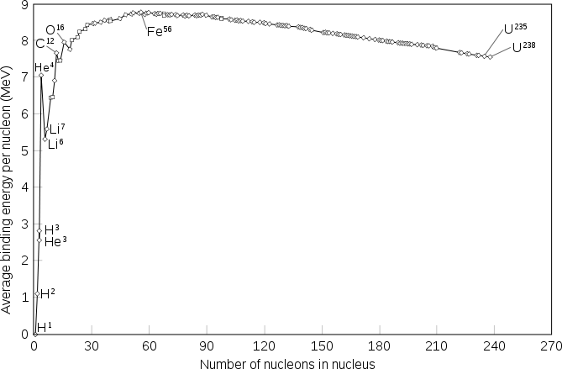
The most tightly bound nuclei are elements around iron (Fe)
Plot shows the average Binding Energy per Nucleon (in MeV)
Average Binding energy is given by:
= (Mnucleus c² – Z mpc² – N mnc²)/(Z + N)
Where Z is the number of protons and N the number of neutrons in nucleus.

Slide 10
Nuclear Fission – splitting a nucleus into two smaller nuclei.
Note that splitting the nucleus of heavy elements such as Uranium, the resulting smaller nuclei are more tightly bound (thus they have less mass) and rest mass energy is extracted.
Nuclear Fusion – combining nuclei to form a larger nucleus.
Fusing light elements, such as hydrogen, results in a larger nucleus that is more tightly bound (thus it has less mass) the difference in rest mass or binding energy is extracted.
Elements heavier than iron can produce energy by fission (atomic bombs, nuclear reactors).
Elements lighter than iron can produce energy by fusion.

Slide 11
Fission Reactions (example):
²³⁵U has 92 protons and 143 neutrons and is naturally radioactive – meaning it will decay to ²³¹Th (90 protons and 141 neutrons) by emitting an alpha particle (⁴He nuclei containing 2 protons and 2 neutrons). The reaction:
²³⁵U → ²³¹Th + ⁴He (half-life 700 million years)
Can compute the rest mass energy released:
Mass of ²³⁵U = 3.902996x10⁻²² gm
Mass of ²³¹Th = 3.836448x10⁻²² gm
Mass of ⁴He = 0.066465x10⁻²² gm
M(²³⁵U) – M(²³¹Th) – M(⁴He) = 0.000083x10⁻²² gm
Thus a rest mass of 8.3x10⁻²⁷ gm is extracted or a rest mass energy (E = mc² ) of = 4.7 MeV.

Slide 12
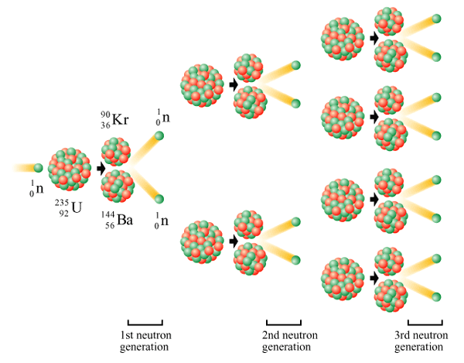
Chain Reactions:
²³⁵U can be induced to fission into two much more tightly bound nuclei by the impact of a neutron leading to a ⁹⁰Kr nucleus, a ¹⁴⁴Ba nucleus and two neutrons. Each fission releases about 200 MeV of energy.
The two neutrons can trigger further ²³⁵U to fission leading to a sustained chain reaction.

Slide 13
Although the binding energy per nucleon is a guide, we need to understand what nuclear reactions can occur in the Sun, and therefore we need to know the composition of the Sun. What is the Sun made of ???
By number of atoms: hydrogen 91.2 %
helium 8. 7 %
other (O, C, N, ...) 0. 1 %
By mass: hydrogen 71.0 %
helium 27.1 %
other (O, C, N, ...) 1.9 %
Based on abundances in the Sun, concentrate on fusion reactions of hydrogen or possible helium. In the interior of the Sun, the electrons are all stripped off and have bare nuclei.

Slide 14
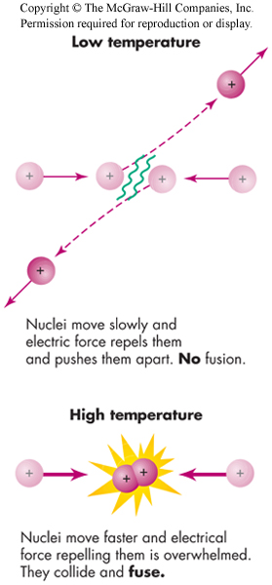
Fusion of Hydrogen
Unlike the formation of a deuteron, there is a problem ! What is it ??
Hydrogen nuclei consist of a proton. The proton is positively charged and repels other protons. Thus at low speeds, the repulsive electric force prevents the nuclei from coming very close to each other.
Nuclear fusion reactions require very high temperatures (high speeds) for the nuclei to come close enough for the strong force (a short range force) to bind them together.
But this is not the entire story.

Slide 15
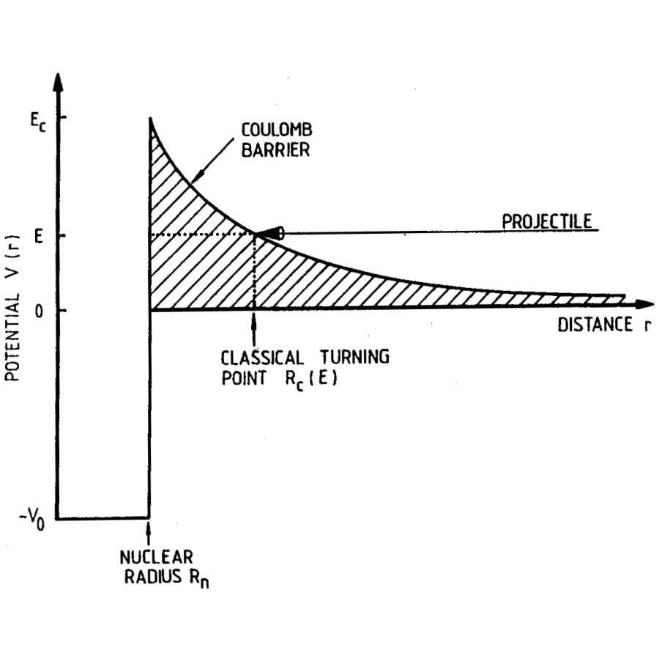
Shown is the potential energy between two protons (considering both electric and strong forces). The electric force is replusive, so there is a large Coulomb barrier, the potential energy is positive and grows with decreasing distance. At distances <10⁻¹³ cm the strong force dominates, which is an attractive force between the two protons.
Fcoulomb = -q1 q2/r²
Ucoulomb = q1 q2/r
Remember that: F = dU/dr

Slide 16
Coulomb Barriers:
These can be quite large:
p + p Ec = 0.55 MeV
p + ¹⁴N Ec = 2.27 MeV
⁴He + ¹²C Ec = 3.43 MeV
¹⁶O + ¹⁶O Ec = 14.07 Mev
The nuclear reaction we are first interested in is:
p + p → ²H + e⁺ + ν
where ²H is a deuteron (p + n), e⁺ is a anti-electron or positron (needed to conserve charge), and ν is a neutrino (needed to conserve lepton number). (Also conserve baryon number.) Note that for this reaction to proceed needs a beta-decay (mediated by weak force) to occur while the protons are close together – very unlikely, so this reaction is extremely slow.

Slide 17
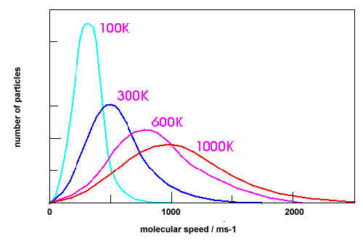
Remember the temperature of the core of the Sun is about 1.5x10⁷ °K. Thus the average thermal energy of a proton is:
3/2 kT = 3/2 (1.38x10⁻¹⁶ ergs K⁻¹) (1.5x10⁷ °K) = 3.1x10⁻⁹ ergs
Converting to eV: 1.9x10³ eV, 1.9 keV, or only 0.0019 MeV !!!
This is not nearly enough energy to get over the Coulomb barrier of 0.55 Mev !!!
Note it would take a temperature of 4x10⁹ K, for the average particle to clear the Coulomb barrier. What gives ????
It is true that some protons have much larger velocities, but need to exceed the average by greater than 200. We need another trick, and this comes from quantum mechanics.

Slide 18
First, we compute classical turning point for two particles with charge Z1e and Z2e (p-p: Z1=Z2 =1), where e = 4.8x10⁻¹⁰ esu)
The Coulomb potential energy is:
UC = Z1 Z2 e²/r
Turning point radius (rc), for a particle with energy, E, is then:
E = UC = Z1 Z2 e²/rc
Solving for rc: rc = Z1 Z2 e²/E
For a proton - proton interaction with E = 3.1x10⁻⁹ ergs (average energy at 15 million K), the turning radius is approximately: rc = 8x10⁻¹¹ cm. (remember it needs to get to < 10⁻¹³ cm !!!!)

Slide 19

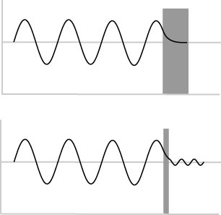
Quantum Mechanical Tunneling
However, particles have wave properties and are not localized to one position, can be represented by a wave packet (or probability distribution).
Therefore there is a non-zero probability of finding proton inside the classical turning radius, even if it does not have sufficient E.
A particles ability to penetrate the barrier (called tunneling) is related to the particle's de Broglie wavelength, given by:
λ = h/p = h/(2mE)^{1/2}
for a 1.9 KeV proton: λ = 7x10⁻¹¹ cm

Slide 20
Quantum Mechanical Tunneling
A rough estimate of when quantum tunneling is important is when the two nuclei are within about one de Broglie wavelength of one another.
Thus: λ = h/(2mE)^{1/2} > rc = Z1 Z2 e²/E
Solving for E: E > 2 m Z1² Z2² e⁴/h²
Since 〈E = 3/2 kT: T > 4/3 m Z1² Z2² e⁴/(k h²), or
T > 2x10⁷ (m/mp) Z1² Z2²
For the proton-proton reaction, need T greater than 20 million K, still above the temperature of the core of the Sun, but many protons in the tail of the Maxwell-Boltzmann distribution have the necessary energy to tunnel.

Slide 21
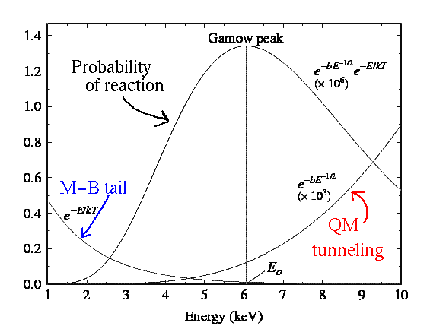
Gamow Peak
The probability of a particle with energy E in the tail of the Maxwell-Boltzmann distribution is proportional to exp(-E/kT). The tunneling probability is proportional to exp(-r_{c}/λ), substituting the energy dependence gives: exp [- (bE)^{-1/2}].
Combining the two probability distributions defines a preferred energy range where tunneling is most likely. This is called the Gamow Peak after George Gamow.

Slide 22
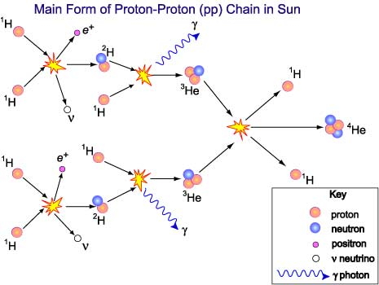
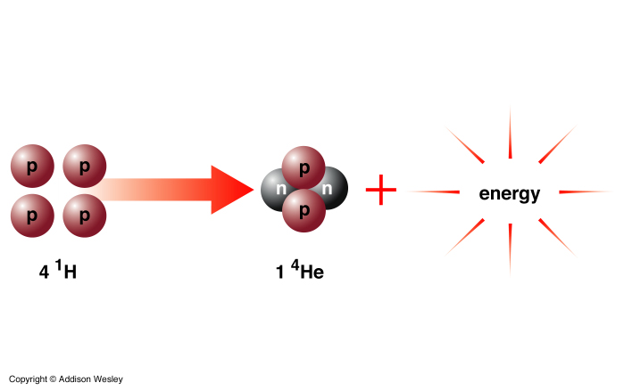
Hydrogen fusion in the Sun is a 3-step process (called the proton-proton or pp chain): (1) Hydrogen (¹H) nuclei first combine to form deuterium (²H). (2) Then, deuterium and hydrogen combine to form ³He
(3) Finally two ³He nuclei combine to form ⁴He.
The net result is the fusion of 4 hydrogen atoms into 1 helium atom.

Slide 23
PP Chain Energy:
¹H + ¹H → ²H + e⁺ + ν E = 0.42 MeV
e⁺ + e⁻ → 2γ E = 1.02 MeV
²H + ¹H → ³He + γ E = 5.49 MeV
³He + ³He → ⁴He + ¹H + ¹H E = 12.86 MeV
The net result: 4 ¹H → ⁴He. Energy produced:
E = 2 (0.42 + 1.02 + 5.49) + 12.86 = 26.7 MeV
Mass of 4 hydrogen nuclei = 6.691x10⁻²⁴ gm
Mass of 1 helium nuclei = 6.645x10⁻²⁴ gm
Mass difference = 0.046x10⁻ ²⁴ gm
E = m c² = (0.048x10⁻²⁴ gm)(3x10¹⁰ cm/s)²
= 4.14x10⁻⁵ ergs or 26 MeV

Slide 24
Lifetime of the Sun
Fusion of 4 H nuclei → 1 He nucleus, generates about 1x10⁻⁵ ergs per H nuclei. So how do we estimate the Sun's lifetime ?
The lifetime is just the total number of hydrogen nuclei that can be fused by the rate in which they are fused.
What is the rate at which hydrogen nuclei are fused into helium?
The rate of which hydrogen nuclei are fused into helium is:
rate = luminosity of Sun/energy per H
rate = 3.8x10³³ ergs s⁻¹ / 1x10⁻⁵ ergs per hydrogen nuclei
rate = 3.8x10³⁸ hydrogen nuclei s⁻¹

Slide 25
Lifetime of the Sun
Need the number of H nuclei that can be fused over the Sun's lifetime. Only in core is the temperature sufficiently hot for fusion, and the core has about 15% of Sun's mass. We also know that the fraction of the mass that is hydrogen is about 0.71.
Thus the total number of H nuclei that can be fused is given by:
number = 0.15 x 0.71 x 2x10³³ gm/1.67x10⁻²⁴ gm/H nuclei
number = 1.3x10⁵⁶ H nuclei in core
Remember the lifetime is just the total number of hydrogen nuclei that can be fused by the rate in which they are fused:
Lifetime = number/rate = 1.3x10⁵⁶ /3.8x10³⁸ s⁻¹ = 3.4x10¹⁷ s
or about 10 billion years

Slide 26
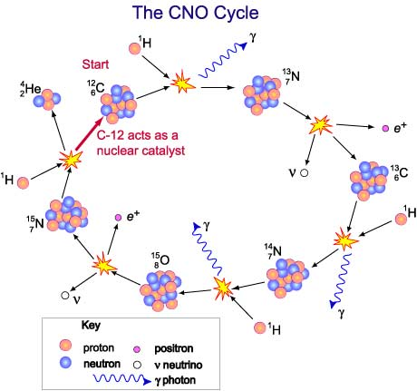
The CNO cycle and pp chain:
Another reaction chain is called the CNO cycle, where carbon acts to catalyze the nuclear reactions. Removes the slow beta-decay, but increases the Coulomb barrier.
The net result is the same as the pp chain, that 4 H nuclei are fused into 1 He nuclei.

Slide 27
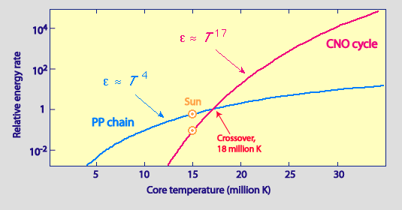
The CNO cycle and pp chain:
More massive stars have higher central temperatures when on the main sequence and CNO cycle is faster than the pp chain and is responsible for most of the energy production:

Slide 28
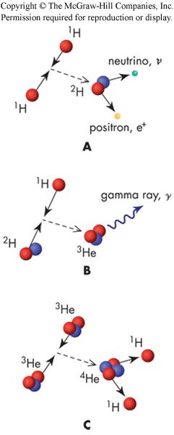
Solar Neutrinos
One of products of the fusion of hydrogen are neutrinos. Neutrinos are nearly mass-less particles that interact very poorly with other matter. Because they do not interact with matter, they are difficult to detect.
They stream out of the center of the Sun and to the Earth with almost no loss (we are peppered with an enormous number of neutrinos every second).
Neutrinos produced in the normal pp chain are relatively low energy, high energy neutrinos are produced is much smaller numbers by other beta decays.

Slide 29
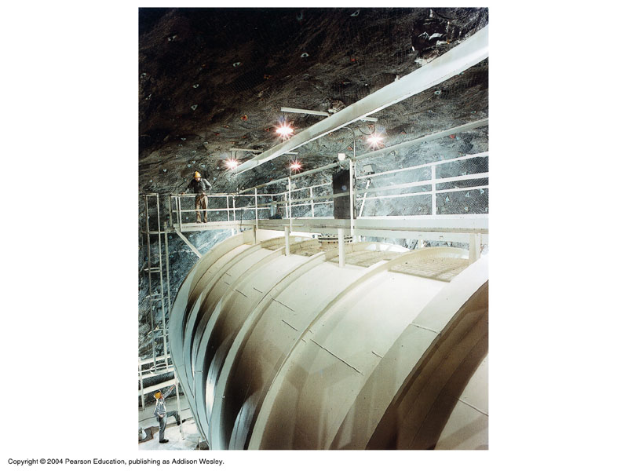
Solar Neutrinos
Detection of neutrinos provides direct evidence for the nuclear fusion reactions occurring in the core now.
The earliest detector was a tank with 100,000 gallons of cleaning fluid. The most energetic neutrinos (not pp neutrinos) could be detected by reaction with chlorine:
³⁷Cl + ν → ³⁷Ar + e-
The argon could be removed and since ³⁷Ar is radioactive, the number counted. Thus the flux of neutrinos could be determined. (Only about 10 to 15 events each month !!!)

Slide 30
Solar Neutrinos
The results were confusing, and showed about 1/3 of the flux of neutrinos that were expected. Solar neutrino problem ???
Gallium detectors were developed to detect the lower energy neutrinos directly produced in standard pp chain.
They also detected fewer than predicted by solar models.
Resolution appears to be with the neutrino. There are three types of neutrinos (electron, muon and tau). The Sun produces electron neutrinos and these are the same type that the chlorine and gallium experiments can detect. However, the neutrinos can change type (neutrino oscillation) during their travel from the center of the Sun to the Earth, reducing the number of electron neutrinos detected at Earth.

Slide 31
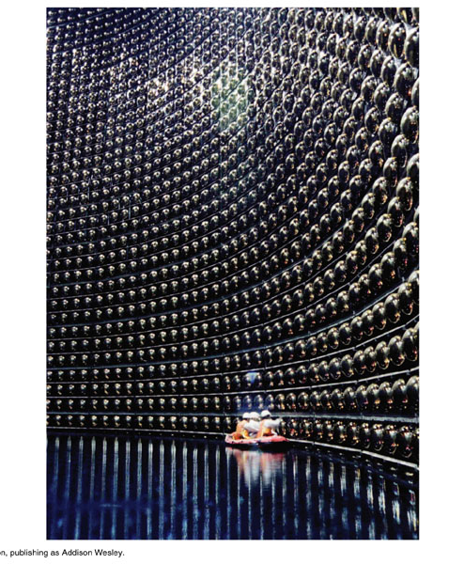
Solar Neutrinos
The newest neutrino detectors are heavy water detectors. Although these are only sensitive to energetic neutrinos, they can detect all three flavors of neutrinos and discern the differences.
The results of these experiments confirm the neutrino oscillation hypothesis. The Sun appears to behaving as expected.
Current and planned detectors, will push neutrino astronomy into new areas. For instance the detection of type II supernovae, ......

